Slide 1
JNCIS-ENT
Open Shortest Path First (OSPF)

Slide 2
The DR and BDR
4
The Designated Router and its Backup

Slide 3
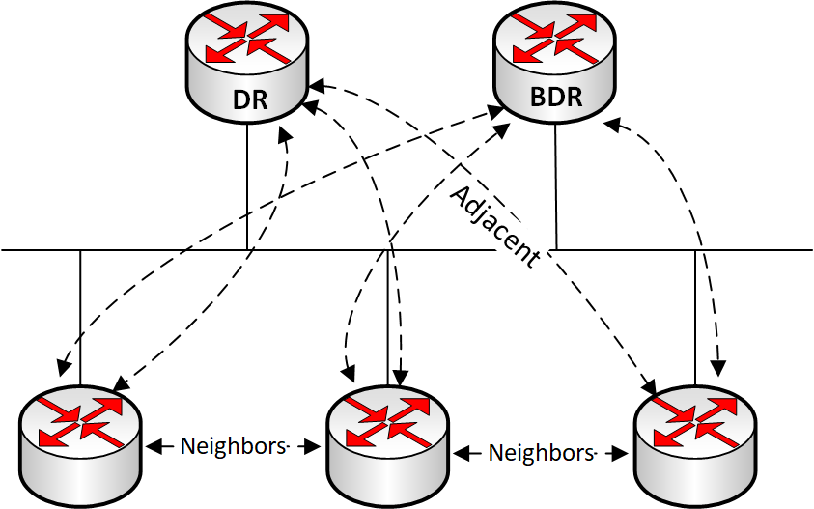
Why a DR / BDR?
In a single broadcast domain, all OSPF speaking routers would try to form full adjacencies and perform database synchronization with all other OSPF speakers on the segment
OSPF was created in a time when bandwidth was at a premium
The DR and BDR are the elected sources of truth for a broadcast segment
Only the DR and BDR will flood LSAs to OSPF speakers on the segment
This will minimize traffic on the broadcast segment
Notes:
*DR and BDR will be explained in the next video

Slide 4
DR Election Process
The highest router priority will be elected as the DR, the second as the BDR
Election occurs for 40 seconds, after this time a higher priority will not preempt the existing
If the priority is the same, the router with the highest RID will be elected DR, and the second highest as BDR
The hello packet includes the RIDs of the routers which the advertising router believes to be the DR and BDR
Network mask*
Hello interval*
Dead interval*
Options*
Neighbors
Router Priority
Designated Router
Backup Designated Router

Slide 5
Configuring Router Priority
Default router priority is 128
The configurable value is 0-255
A higher priority is needed to win a DR / BDR election
lab@SW1> show configuration protocols
ospf {
area 0.0.0.0 {
interface ge-0/0/2.0 {
priority 128;
}
}
}
lab@SW1# set protocols ospf area 0.0.0.0 interface ge-0/0/2.0 priority ?
Possible completions:
<priority> Designated router priority (0..255)

